Slide 1
A 4/3 Approximation for 2-Vertex-Connectivity
Miguel Bosch-Calvo
IDSIA, USI-SUPSI, Lugano, Switzerland
Fabrizio Grandoni
IDSIA, USI-SUPSI, Lugano, Switzerland
Afrouz Jabal Ameli
TU Eindhoven, The Netherlands

Slide 2
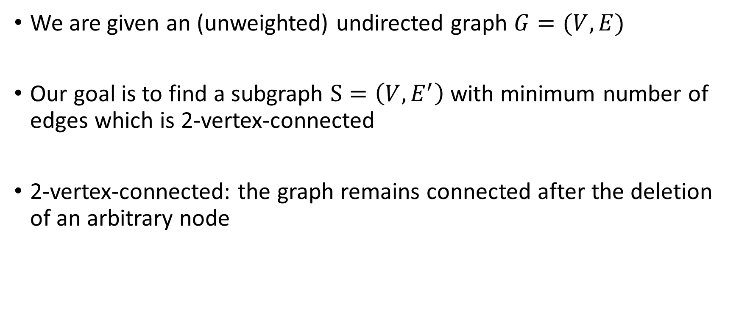
2-Vertex-Connected Spanning Subgraph problem (2VCSS)
We are given an (unweighted) undirected graph $G=(V,E)$
Our goal is to find a subgraph $S=\left(V,E^{′}\right)$ with minimum number of edges which is 2-vertex-connected
2-vertex-connected: the graph remains connected after the deletion of an arbitrary node

Slide 3
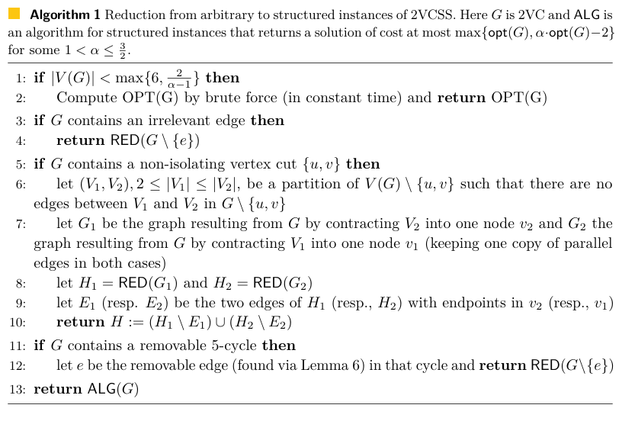
Overview of the Algorithm

Slide 4
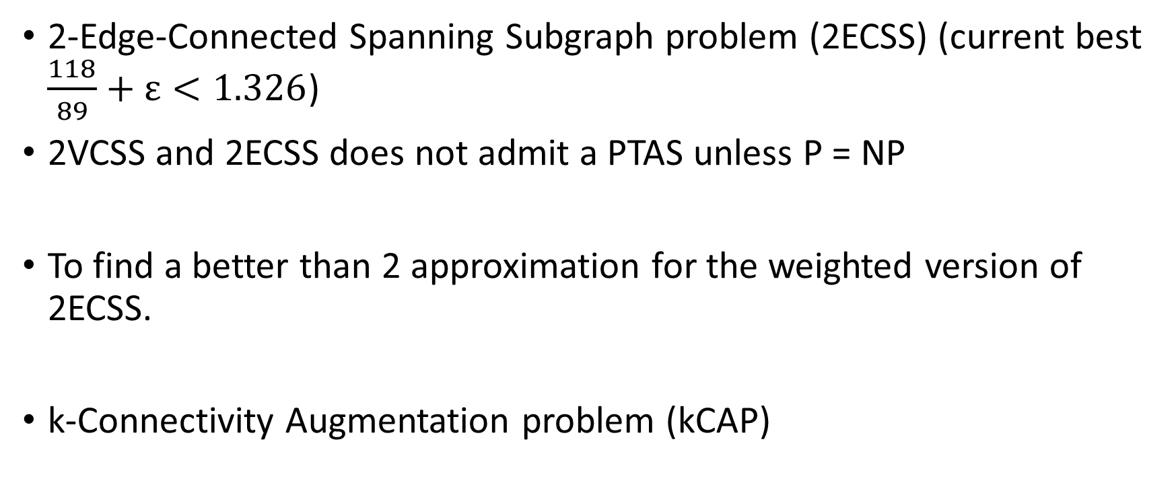
Related Work
2-Edge-Connected Spanning Subgraph problem (2ECSS) (current best $\frac{118}{89}+ε<1.326$)
2VCSS and 2ECSS does not admit a PTAS unless P = NP
To find a better than 2 approximation for the weighted version of 2ECSS.
k-Connectivity Augmentation problem (kCAP)

Slide 5
A Tight (1.5 + ϵ)-Approximation for Unsplittable Capacitated Vehicle Routing on Trees
Claire Mathieu
CNRS Paris, France
Hang Zhou
École Polytechnique, Institut Polytechnique de Paris, France

Slide 6
Unsplittable Capacitated Vehicle Routing Problem (UCVRP) on trees
We are given a rooted tree with edge weights and a subset of vertices of the tree called terminals
Each terminal is associated with a positive demand between 0 and 1
The goal is to find a minimum length collection of tours starting and ending at the root of the tree such that the demand of each terminal is covered by a single tour (i.e., the demand cannot be split)
The total demand of the terminals in each tour does not exceed the capacity of 1

Slide 7
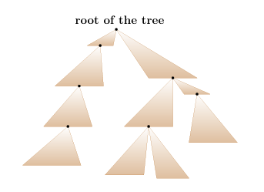
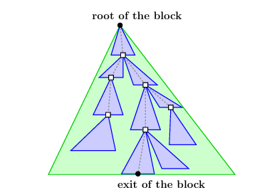
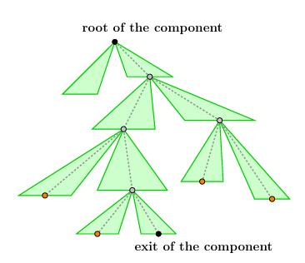
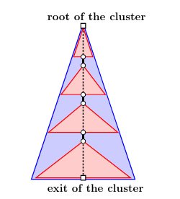
Overview of the Algorithm

Slide 8
Related Work
UCVRP on general metrics (the best-to-date approximation ratio for general metrics stands at roughly 3.194)
UCVRP in the Euclidean plane (in the two-dimensional Euclidean plane, the UCVRP admits a (2 + ϵ)-approximation)
UCVRP on paths (prior to this paper, the best approximation ratio for the UCVRP on paths was 1.6)

